Slide 1
Merge
Split
Team C
Caleb Albrecht
Haim Hong
Nathanael Kastner
Papa Kwesi Sterlin
Jacob Westra
Notes:
Note to everyone: We should base this off https://cs.calvin.edu/courses/cs/262/kvlinden/15project/project4.html
10% — Vision
20% — Design
40% — Demo
10% — Assessment
10% — Questions
10% — Timing

Slide 2
Template Slide

Slide 3
Vision

Slide 4
Assessment
Technology giveth and technology taketh…
These trade-offs are not evenly distributed
Notes:
Strengths/weaknesses

Slide 5
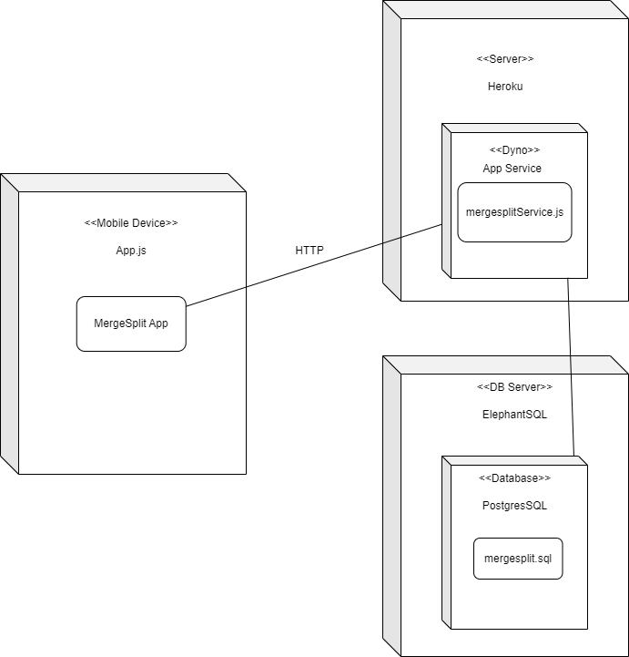
Design
Notes:
Give an overview of your system design, including the deployment diagram. Take time to discuss the changes you implemented (if any) as a result of the usability testing.

Slide 6
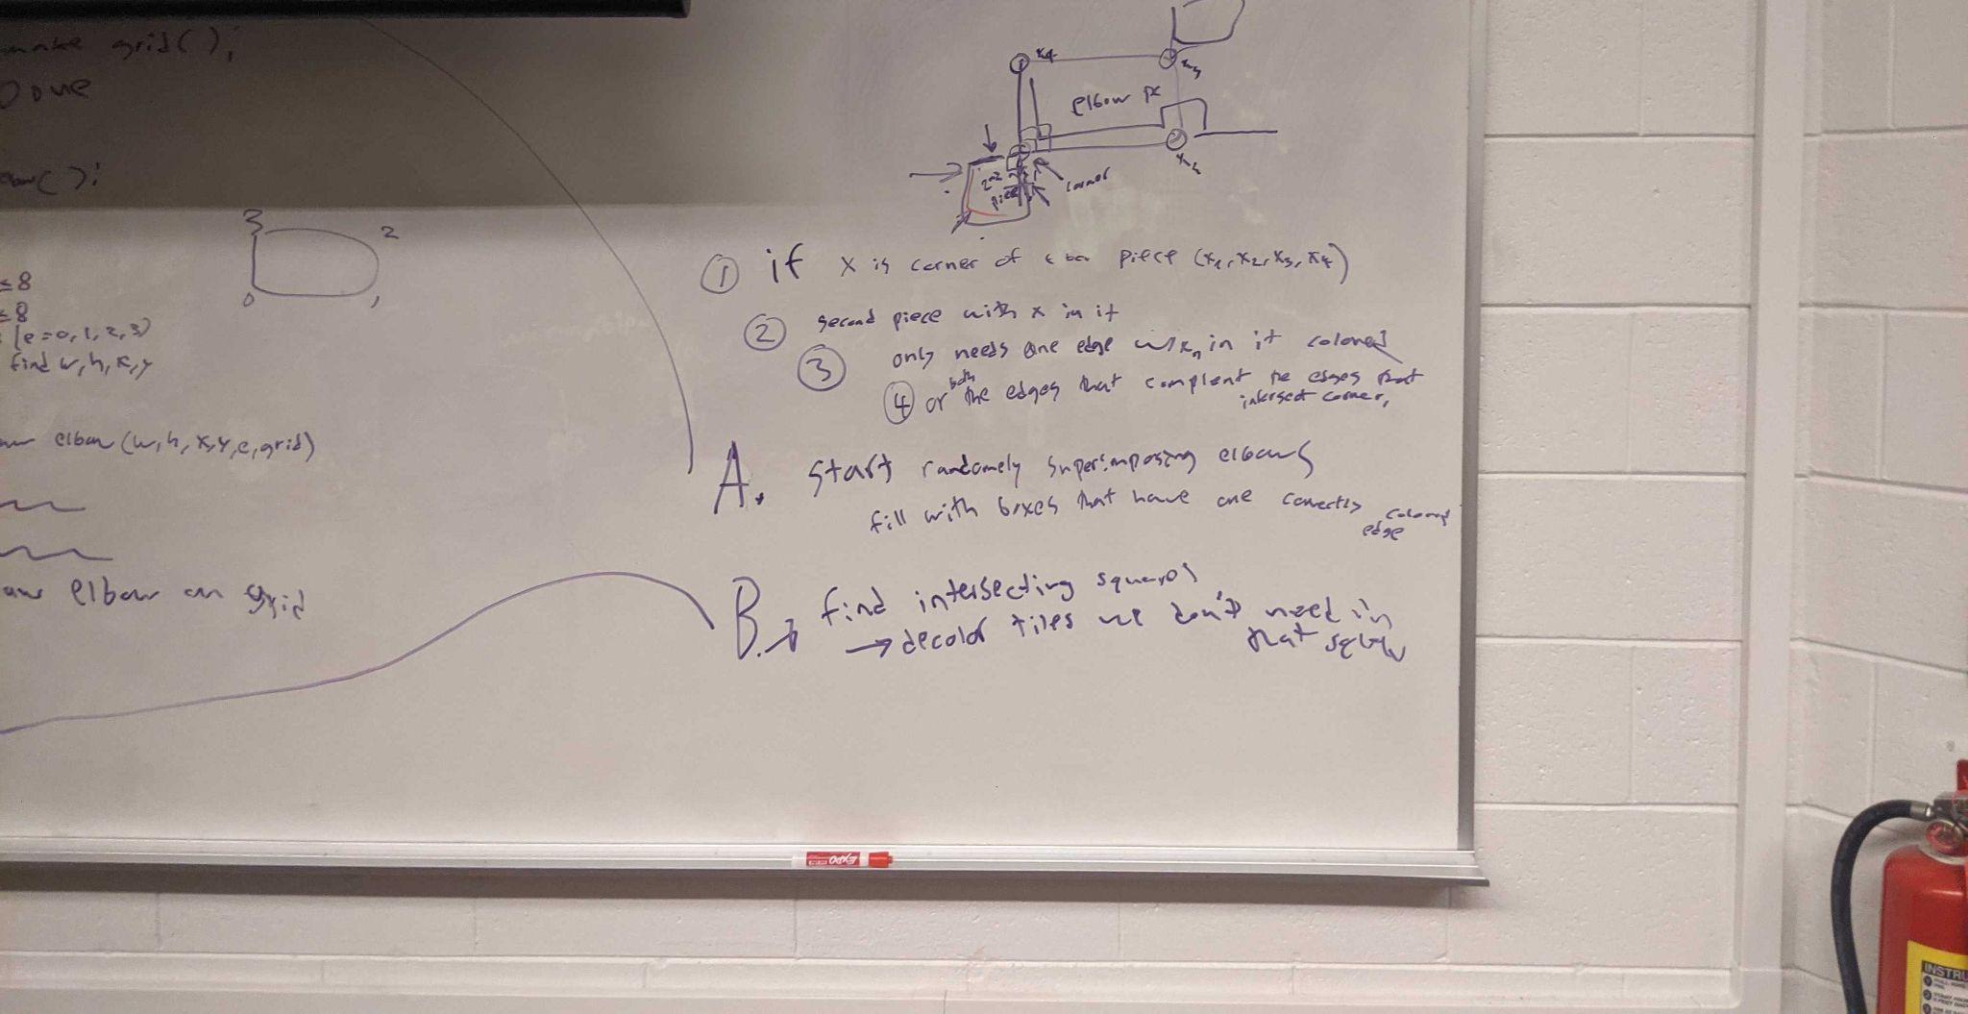
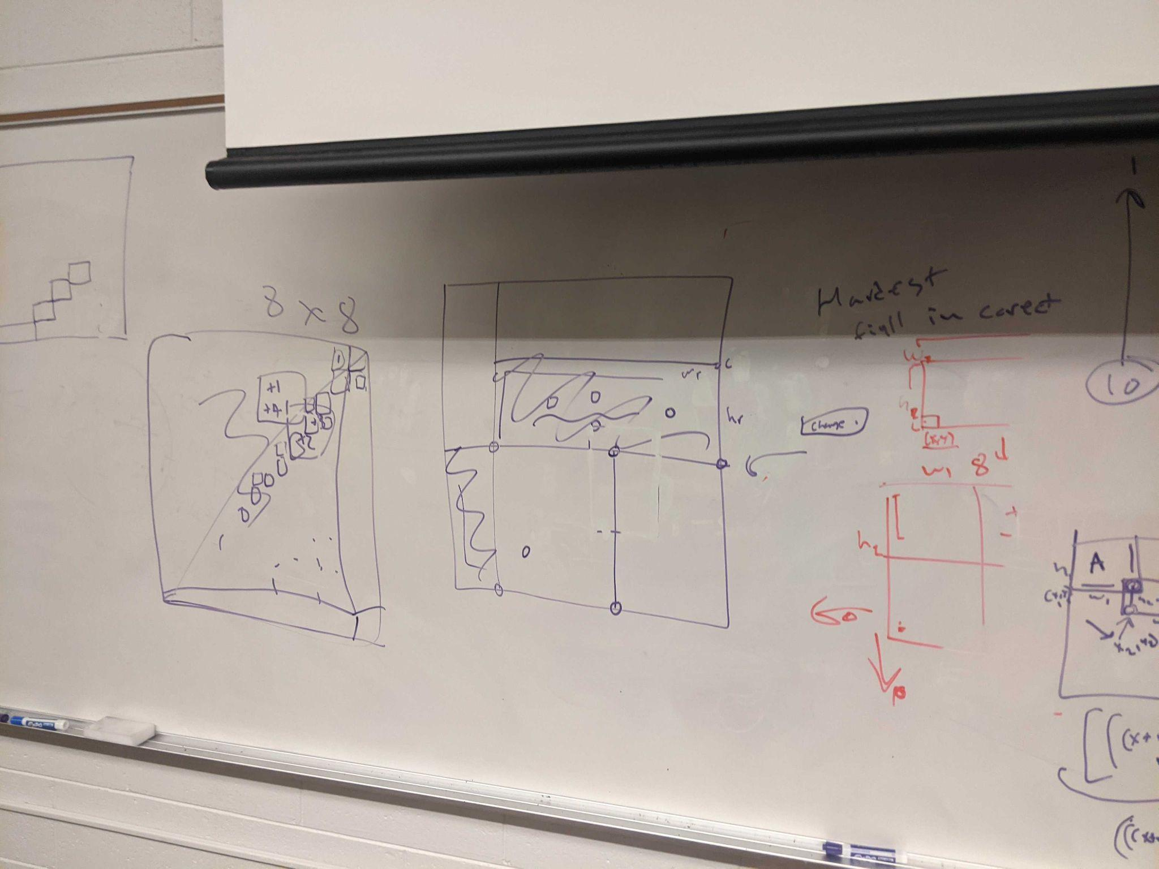
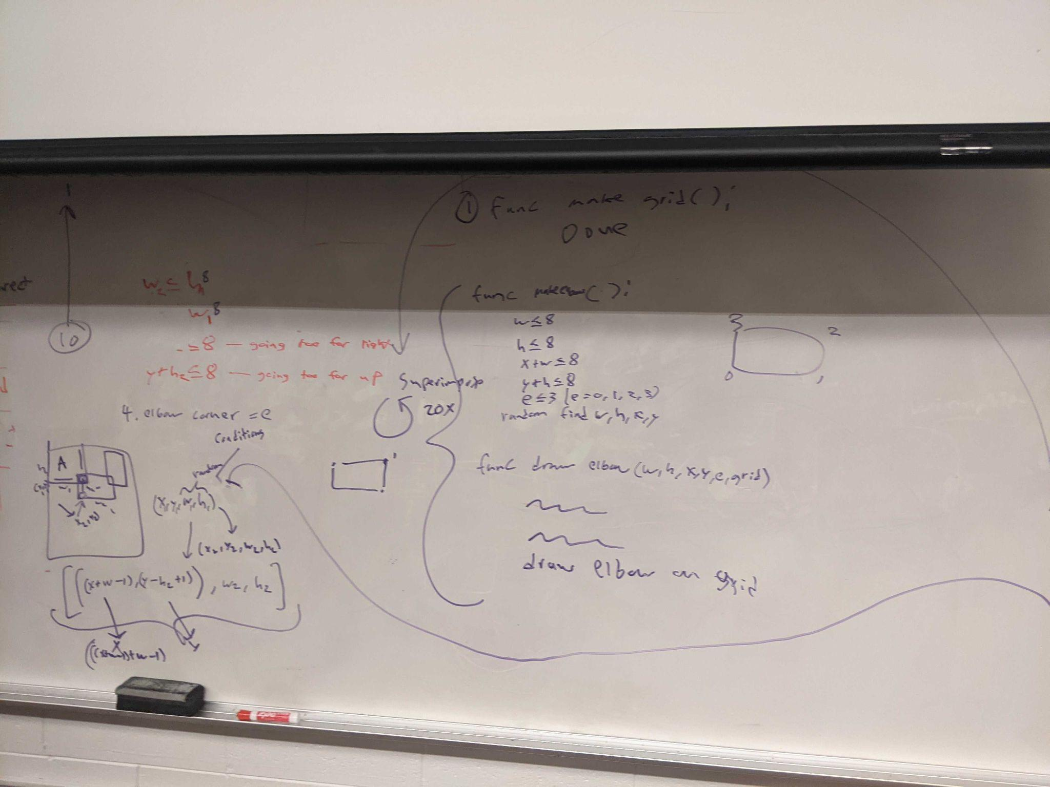
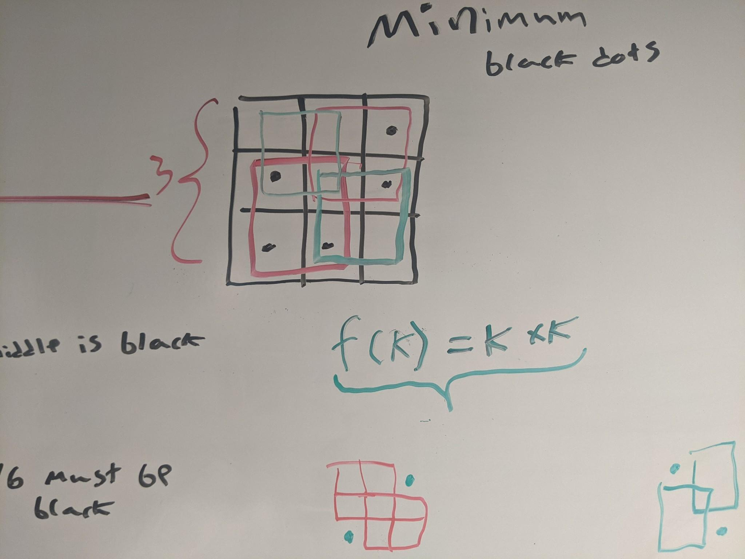
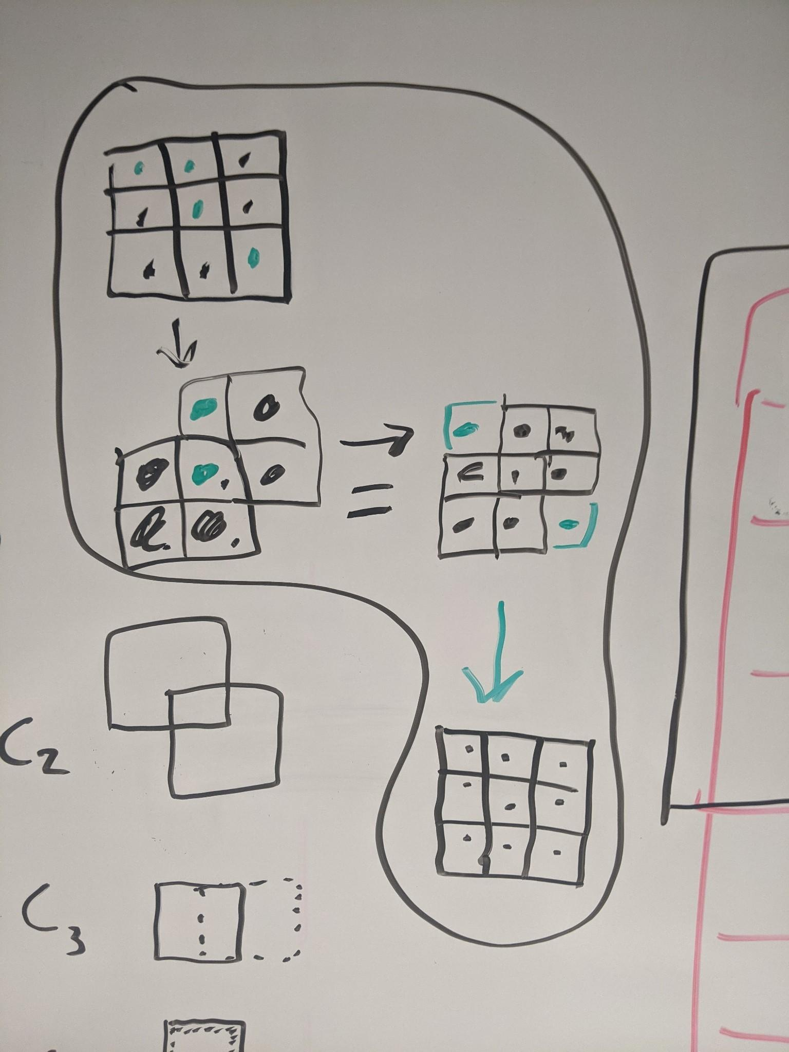

Slide 7
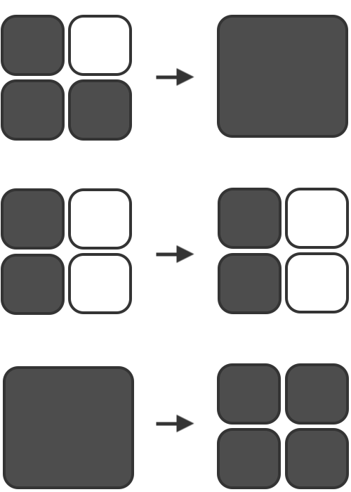

Slide 8
Q&A
Notes:
Strengths/weaknesses

Slide 9
Thx!
Notes:
Strengths/weaknesses

